Slide 1


Slide 2



STATEMENT INTERFACE
IN
JAVA

Slide 3

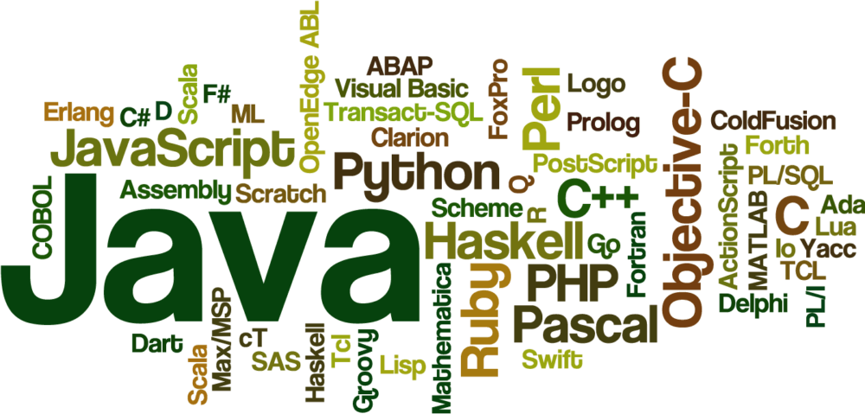


Slide 4
Statement interface
The Statement interface provides methods to execute queries with the database.
The statement interface is a factory of ResultSet i.e. it provides factory method to get the object of ResultSet.
Statement stmt=conn.createStatement();

Slide 5
JDBCTest.java
import java.sql.Connection; import java.sql.Statement; import com.codesjava.util.JDBCUtil; /** * This class is used to create a table in DB. */ public class JDBCTest { public static void main(String args[]) { Connection conn = null; Statement statement = null; String query = "create table EMPLOYEE(" + "EMPLOYEE_ID NUMBER(5) NOT NULL, " + "NAME VARCHAR(20) NOT NULL, " + "SALARY NUMBER(10) NOT NULL, " + "PRIMARY KEY (EMPLOYEE_ID) )"; try{` | //get connection conn = JDBCUtil.getConnection(); //create statement statement = conn.createStatement(); //execute query statement.execute(query); //close connection statement.close(); conn.close(); System.out.println("Table created successfully."); }catch(Exception e){ e.printStackTrace(); } } }

Slide 6
JDBCUtil.java(CONNECTOR PROGRAM TO ORACLE)
import java.sql.Connection; import java.sql.DriverManager; public class JDBCUtil { //JDBC and database properties. private static final String DB_DRIVER = "oracle.jdbc.driver.OracleDriver"; private static final String DB_URL = "jdbc:oracle:thin:@localhost:1521:XE"; private static final String DB_USERNAME = "system"; private static final String DB_PASSWORD = "oracle"; public static Connection getConnection() { Connection conn = null; | try{ //Register the JDBC driver Class.forName(DB_DRIVER); //Open the connection conn = DriverManager. getConnection(DB_URL, DB_USERNAME, DB_PASSWORD); if(conn != null){ System.out.println("Successfully connected."); }else{ System.out.println("Failed to connect."); } }catch(Exception e){ e.printStackTrace(); } return conn; } }
Notes:
Successfully connected.
Table created successfully

Slide 7
METHODS IN STATEMENTS INTERFACE

Slide 8
EXECUTE QUERY
public ResultSet executeQuery(String sql):
Parameters:
sql - an SQL statement to be sent to the database, typically a static SQL SELECT statement
Returns:
a ResultSet object that contains the data produced by the given query; never null
Notes:
Executes the given SQL statement, which returns a single ResultSet object.
Note:This method cannot be called on a PreparedStatement or CallableStatement.
Throws:SQLException - if a database access error occurs, this method is called on a closed Statement, the given SQL statement produces anything other than a single ResultSet object, the method is called on a PreparedStatement or CallableStatement
SQLTimeoutException - when the driver has determined that the timeout value that was specified by the setQueryTimeout method has been exceeded and has at least attempted to cancel the currently running Statement

Slide 9
executeUpdate
int executeUpdate(String sql) throws SQLException
Parameters:
sql - an SQL Data Manipulation Language (DML) statement, such as INSERT, UPDATE or DELETE; or an SQL statement that returns nothing, such as a DDL statement.
Returns:
either (1) the row count for SQL Data Manipulation Language (DML) statements or (2) 0 for SQL statements that return nothing
Notes:
Throws:SQLException - if a database access error occurs, this method is called on a closed Statement, the given SQL statement produces a ResultSet object, the method is called on a PreparedStatement or CallableStatement
SQLTimeoutException - when the driver has determined that the timeout value that was specified by the setQueryTimeout method has been exceeded and has at least attempted to cancel the currently running Statement

Slide 10
LOGIC:
import java.sql.Connection; import java.sql.Statement; import com.codesjava.util.JDBCUtil; public class JDBCTest { public static void main(String args[]) { Connection conn = null; Statement statement = null; String query = "insert into EMPLOYEE " + "(EMPLOYEE_ID, NAME, SALARY) " + "values (1, 'Harish Yadav', 50000)"; | try{ //get connection conn = JDBCUtil.getConnection(); //create statement statement = conn.createStatement(); //execute query statement.executeUpdate(query); //close connection statement.close(); conn.close(); System.out.println("Record inserted successfully."); }catch(Exception e){ e.printStackTrace(); } } }
Notes:
Check for slide 5 every time while explaining the code
OUTPUT:Record inserted successfully.

Slide 11
Select records from DB Table
import java.sql.Connection; import java.sql.ResultSet; import java.sql.Statement; import com.codesjava.util.JDBCUtil.; public class JDBCTest { public static void main (String args[]) { Connection conn = null; Statement statement = null; String query = "select EMPLOYEE_ID, NAME from EMPLOYEE"; | try{ //get connection conn = JDBCUtil.getConnection(); //create statement statement = conn.createStatement(); //execute query ResultSet rs = statement.executeQuery(query); while (rs.next()) { String empId = rs.getString("EMPLOYEE_ID"); String empName = rs.getString("NAME"); System.out.println("EmpId : " + empId); System.out.println("EmpName : " + empName); } //close connection statement.close(); conn.close(); } catch(Exception e){ e.printStackTrace(); } } }
Notes:
Successfully connected.
EmpId : 7
EmpName : Harish Yadav
EmpId : 2
EmpName : vivek
EmpId : 3
EmpName : Himanshu
EmpId : 1
EmpName : Bharat
EmpId : 4
EmpName : Bharti
EmpId : 8
EmpName : Abhishek Rathor
EmpId : 11
EmpName : Harish Kansal
EmpId : 12
EmpName : Vivek Solenki

Slide 12
ResultSet interface
The object of ResultSet maintains a cursor pointing to a row of a table.
Initially, cursor points to before the first row.
By default, ResultSet object can be moved forward only and it is not updatable.
But we can make this object to move forward and backward direction by passing either TYPE_SCROLL_INSENSITIVE or TYPE_SCROLL_SENSITIVE in createStatement(int,int) method as well as we can make this object as updatable by:

Slide 13
LOGIC:
import java.sql.*; class FetchRecord{ public static void main(String args[])throws Exception{ Class.forName("oracle.jdbc.driver.OracleDriver"); Connection con=DriverManager.getConnection("jdbc:oracle:thin:@localhost:1521:xe","system","oracle"); Statement stmt=con.createStatement(ResultSet.TYPE_SCROLL_SENSITIVE,ResultSet.CONCUR_UPDATABLE); ResultSet rs=stmt.executeQuery("select * from emp765"); //getting the record of 3rd row rs.absolute(3); System.out.println(rs.getString(1)+" "+rs.getString(2)+" "+rs.getString(3)); con.close(); }}

Slide 14
JDBC prepared Statements
The JDBC Prepared Statement is used to execute parameterized queries against the database.
Prepared Statement is an interface which provides the methods to execute parameterized queries.
A parameter is represented by ? symbol in JDBC. Prepared Statement extends the Statement interface.
We can get a Prepared Statement object by invoking the prepare Statement() method of Connection interface

Slide 15
JDBCTest.java
import java.sql.Connection; import java.sql.PreparedStatement; import com.codesjava.util.JDBCUtil; public class JDBCTest { public static void main(String args[]) { Connection conn = null; PreparedStatement preparedStatement = null; String query = "create table EMPLOYEE(" + "EMPLOYEE_ID NUMBER(5) NOT NULL, " + "NAME VARCHAR(20) NOT NULL, " + "SALARY NUMBER(10) NOT NULL, " + "PRIMARY KEY (EMPLOYEE_ID) )"; | try{ //get connection conn = JDBCUtil.getConnection(); //create preparedStatement preparedStatement = conn.prepareStatement(query); //execute query preparedStatement.execute(); //close connection preparedStatement.close(); conn.close(); System.out.println("Table created successfully."); }catch(Exception e) { e.printStackTrace(); } } }
Notes:
Table created successfully.

Slide 16

THANK YOU

